Slide 1


Ensemble Learning: Boosting and Bagging Algorithms
Dr. Nwe Nwe Htay Win
Professor
Parami Unviersity

Slide 2
Ensemble learning
Ensemble learning is a technique that combines multiple individual models to build a more powerful and accurate predictive model.
It works on the idea that a group of diverse models performs better than a single model.
By leveraging the strengths of different algorithms, ensemble methods help reduce individual model weaknesses.
Ensemble learning improves prediction accuracy by minimizing bias, variance, or both.
It enhances model robustness, making predictions more stable and reliable across different datasets.
Helps in error reduction, as mistakes made by one model can be corrected by others.
Commonly used in classification, regression, and anomaly detection tasks.
Ensemble models often perform better on complex and real-world data.
Widely used in competitions and production systems due to their strong performance.

Slide 3
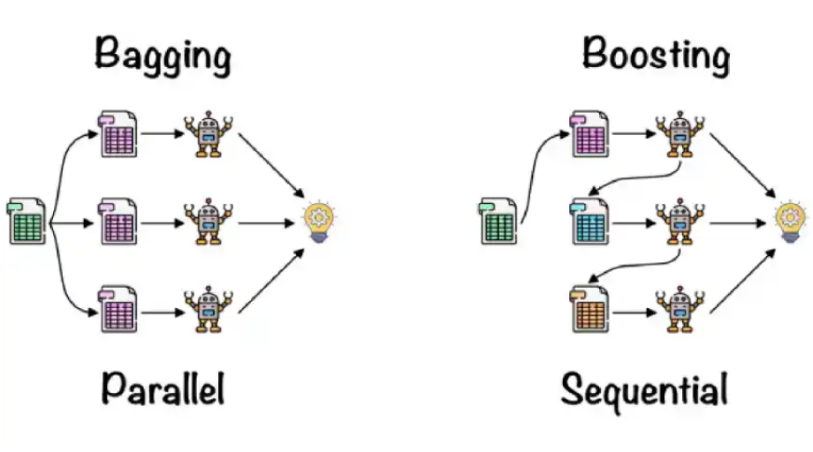
Ensemble Techniques
Bagging (Bootstrap Aggregating):
Trains models independently on different data samples
Reduces variance (e.g., Random Forest)
Boosting:
Trains models sequentially, focusing on previous errors
Improves accuracy (e.g., AdaBoost, Gradient Boosting)
Stacking:
Combines predictions from multiple models using a meta-model

Slide 4
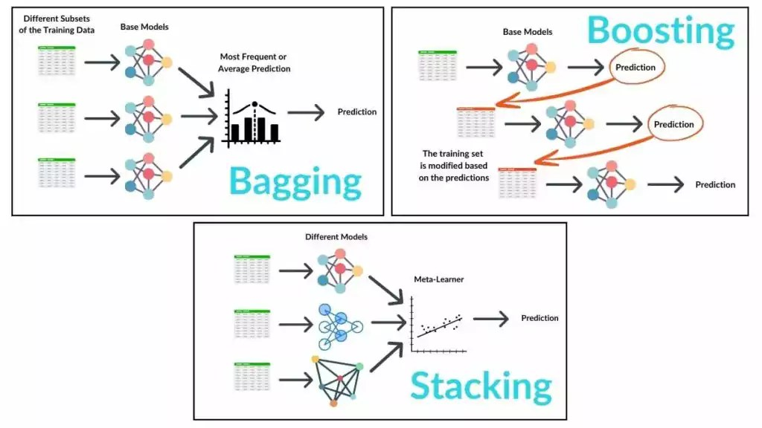
How do they work?
Ref: https://spotintelligence.com/2024/03/18/bagging-boosting-stacking/

Slide 5
What is Bagging?
Bagging is an ensemble learning technique used to improve the accuracy and stability of machine learning models.
It works by training multiple models on different subsets of the same dataset and combining their predictions.
Steps of Bagging Algorithm
Data Sampling:
Multiple subsets of the training data are created using bootstrap sampling (random sampling with replacement).
Model Training:
A separate model is trained independently on each data subset.
Aggregation:
Predictions from all models are combined:
Averaging for regression tasks
Majority voting for classification tasks

Slide 6
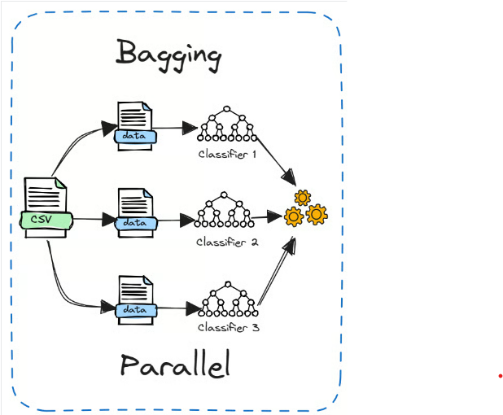
How Does Bagging Work?
Bagging Algorithm Steps
Input Dataset
Start with the original training dataset.
Bootstrap Sampling
Generate multiple random subsets of the dataset using sampling with replacement.
Model Training
Train a separate base model (e.g., decision tree, SVM, neural network) on each bootstrap sample.
Independent Learning
Each model is trained independently and in parallel.
Prediction Phase
For a new input instance, obtain predictions from all trained models.
Aggregation of Predictions
Combine all model outputs:
Averaging for regression problems
Majority voting for classification problems
Final Output
The aggregated result is the final prediction.

Slide 7
Key Benefits of Bagging
Reduces Variance:
Averaging multiple models decreases variance and helps prevent overfitting.
Improves Accuracy:
The combined model generally performs better than individual models.
Increases Stability:
Makes the model less sensitive to noise and fluctuations in the training data.
Works Well with High-Variance Models:
Especially effective for models like decision trees.

Slide 8
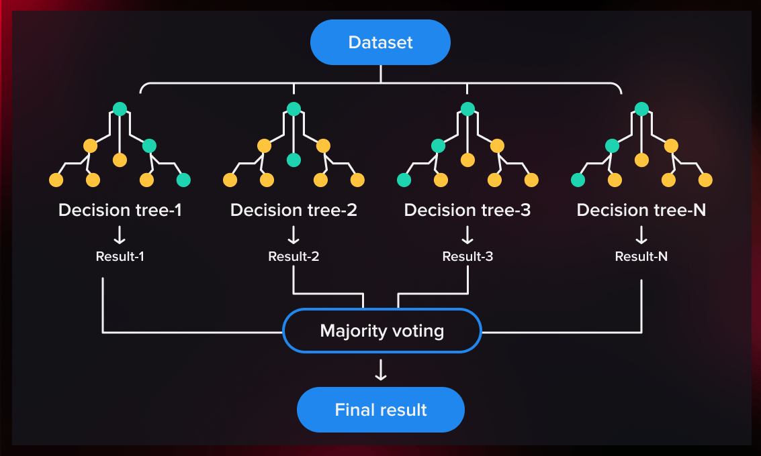
Popular Bagging Algorithm : Random Forest
Random Forest is a powerful ensemble learning algorithm that uses bagging to build a robust and accurate predictive model.
It consists of a collection of decision trees, where each tree is trained on a bootstrap sample of the training data.
To increase diversity among trees, Random Forest introduces random feature selection, considering only a subset of features at each split.
This randomness reduces correlation between trees and improves overall performance.

Slide 9
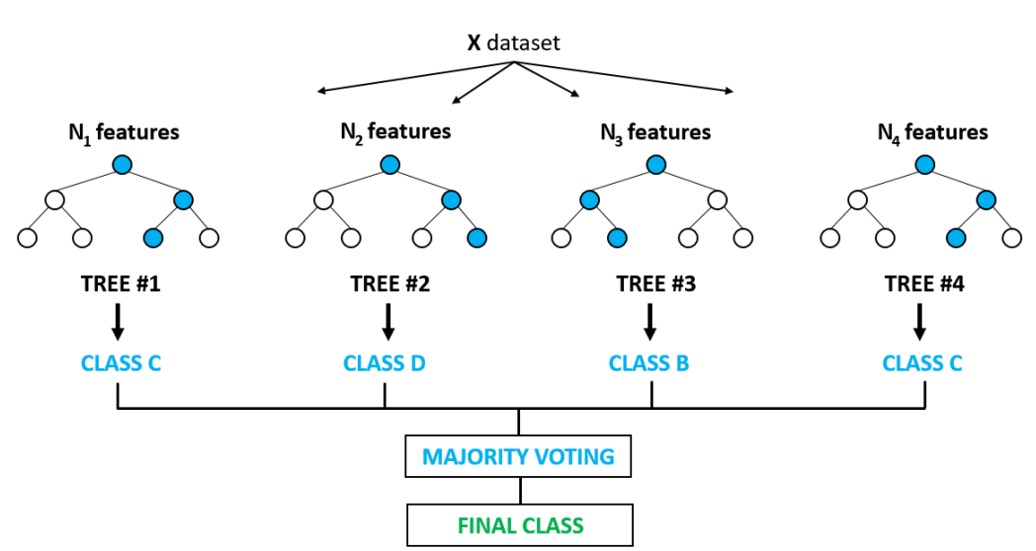
Random Forest Algorithm
Select N random records from the original dataset using bootstrap sampling.
Build a decision tree using these N selected records.
Repeat the above steps by choosing the desired number of trees to create the forest.
For a new data record:
In regression, each tree predicts a value for the output variable Y.
The final prediction is obtained by taking the average of all tree outputs.
In classification, each tree predicts a class label.
The final class is determined by majority voting among all trees.

Slide 10
Hands-on Tutorial for Random Forest

Slide 11
What is Boosting?
Boosting algorithms combine multiple low-accuracy (weak) classifiers to create a highly accurate (strong) classifier.
A weak classifier performs slightly better than random guessing (for example, better than flipping a coin).
Boosting works by training models sequentially:
The first model is trained on the original dataset.
Each subsequent model focuses on correcting the errors made by previous models.
New models are added until:
The training data is predicted accurately, or
A predefined maximum number of models is reached.
The final strong classifier achieves an error rate close to zero by combining all weak learners.
Boosting algorithms can identify and emphasize difficult or misclassified samples during training.
Boosting is less prone to overfitting and often improves performance on complex datasets.

Slide 12
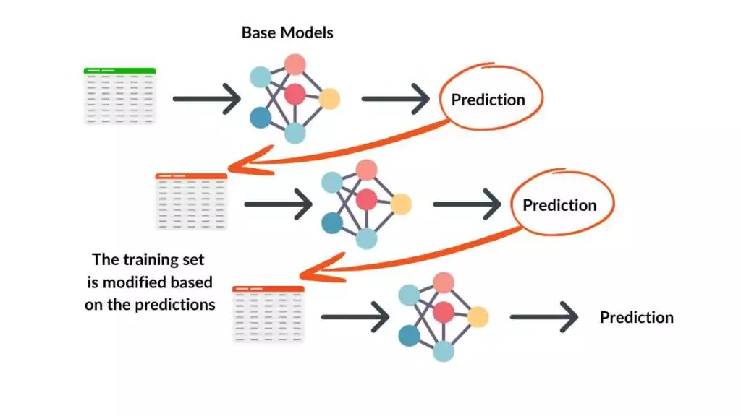
Key Characteristics of Boosting
Builds models sequentially
Focuses on hard-to-classify instances
Reduces bias and improves accuracy
Converts weak learners into a strong learner

Slide 13
Adaboost (Adaptive Boosting)
AdaBoost was the first highly successful boosting algorithm.
It was originally developed for binary classification problems.
AdaBoost assigns higher weights to misclassified samples, forcing subsequent learners to focus on them.
Weak classifiers with higher accuracy receive higher influence in the final prediction.
By combining multiple weak classifiers, AdaBoost produces a strong classifier.
Other Boosting Techniques
Gradient Boosting
XGBoost (Extreme Gradient Boosting)
LightGBM
CatBoost

Slide 14
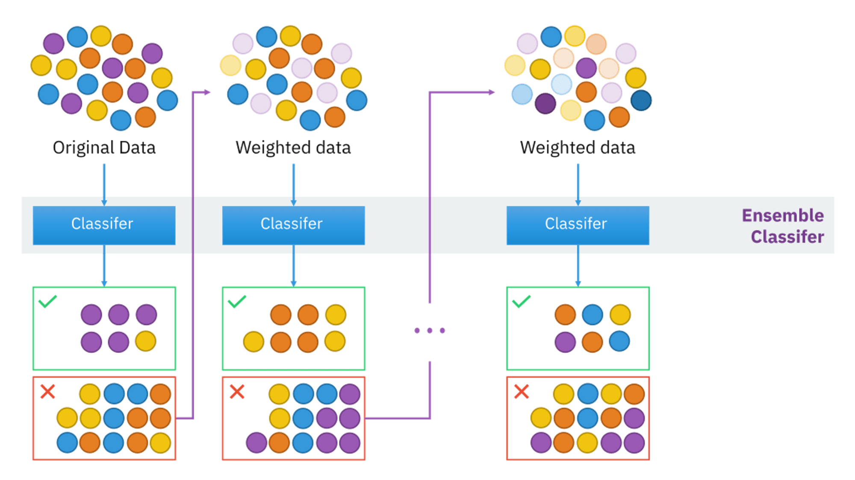
How Adaboost Works?

Slide 15
Steps of Adaboost Algorithm
Step 1: Initialize Sample Weights
Consider a binary classification dataset.
Initially, equal weights are assigned to all training instances.
If there are N data points, each data point is given a weight of 1/N.
At this stage, all samples are treated as equally important..
Step 2: Train the First Weak Classifier
A weak learner (such as a decision stump) is trained using the weighted dataset.
The classifier attempts to separate the data into classes based on a single feature.
Predictions are made for all training samples.
Step 3: Calculate Classification Error
The error rate (ε) of the weak classifier is calculated based on misclassified samples.
Misclassified instances contribute more to the error due to their assigned weights.
Step 4: Assign Weight to the Weak Classifier
A classifier weight (α) is computed based on its accuracy.
A classifier with lower error is given higher importance in the final prediction.
Better-performing classifiers influence the final decision more strongly.

Slide 16
Adaboost Algorithm’s Step Continued
Step 5: Update Sample Weights
Modify weights based on the results of the previous step.
Increase weights for misclassified instances to force the next learner to focus on them.
Decrease weights for correctly classified instances to reduce their priority in the next round.
Normalize the new weights so that the sum of all weights remains equal to 1.
Step 6: Iterate and Combine (Final Prediction)
Repeat the process (Steps 2–5) for multiple iterations, creating a series of learners.
The individual classifiers "vote," and the final prediction is returned based on majority voting.
This results in a single predictive model with increased performance and accuracy.

Slide 17
Overall Workflow
Phase | Action | Purpose
Setup | Equal Weights ($1/N$) | Ensures every point starts with equal importance.
Iterate | Train & Weight Update | Focuses subsequent models on "hard" cases (Boosting).
Result | Weighted Voting | Combines low-performing models into a high-performance ensemble.

Slide 18
Walkthrough of Adaboost Algorithm
Row No. | Credit Score | Approved (Actual) | Sample Weight (wi​)
1 | High | Yes | $1/5 = 0.2$
2 | Low | No | $1/5 = 0.2$
3 | High | No | $1/5 = 0.2$
4 | Low | Yes | $1/5 = 0.2$
5 | High | Yes | $1/5 = 0.2$
Step 1: Create the First Weak Learner (Stump)
Suppose our first decision stump is: "If Credit Score is 'High', predict 'Yes'. Otherwise, predict 'No'."
Row 1: High → Yes (Correct)
Row 2: Low → No (Correct)
Row 3: High → Yes (Incorrect) - Actual is No
Row 4: Low → No (Incorrect) - Actual is Yes
Row 5: High → $ Yes (Correct)

Slide 19

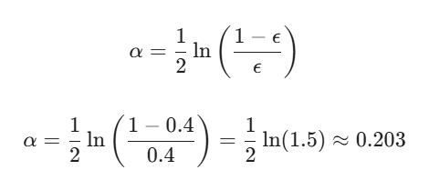



Step 2: Calculate the Total Error (ε )
The total error is the sum of the weights of the misclassified records (Rows 3 and 4).
Step 3: Calculate the Amount of Say (α)
This determines how much influence this specific stump has on the final prediction.
Step 5: Normalize the Weights
The new weights must sum to 1. The current sum is (3 * 0.163) + (2 * 0.245) = 0.489 + 0.490 = 0.979.
Step 4: Update Sample Weights
We increase the weights for the incorrect predictions so the next model focuses on them, and decrease them for the correct ones.
For Correct Predictions (Rows 1, 2, 5):
For Incorrect Predictions (Rows 3,4):

Slide 20
Final Output Table for Next Iteration
The updated weights for the second weak learner would be:
Row No. | Approved (Actual) | Predicted | Result | New Weight
1 | Yes | Yes | Correct | 0.167
2 | No | No | Correct | 0.167
3 | No | Yes | Wrong | 0.250
4 | Yes | No | Wrong | 0.250
5 | Yes | Yes | Correct | 0.167

Slide 21
References
Data Mining: Practical Machine Learning Tools and Techniques (3rd edition) / Ian Witten, Eibe Frank; Elsevier, 2011

Slide 22
Thank You

